Slide 1
Convolutional Neural Networks for Direct Text Deblurring
Michal Hradiš, Jan Kotera, Pavel Zemčík, Filip Šroubek
{ihradis, zemcik}@fit.vutbr.cz
{kotera, sroubekf}@utia.cas.cz
汇报人：李文杰 王燕飞

Slide 2
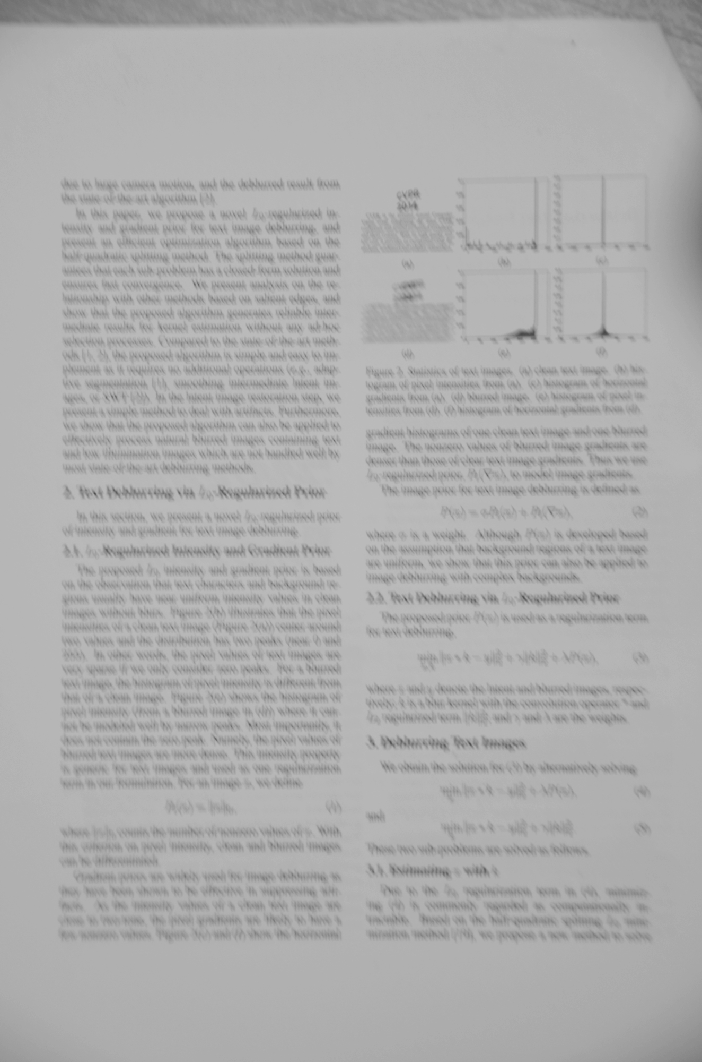
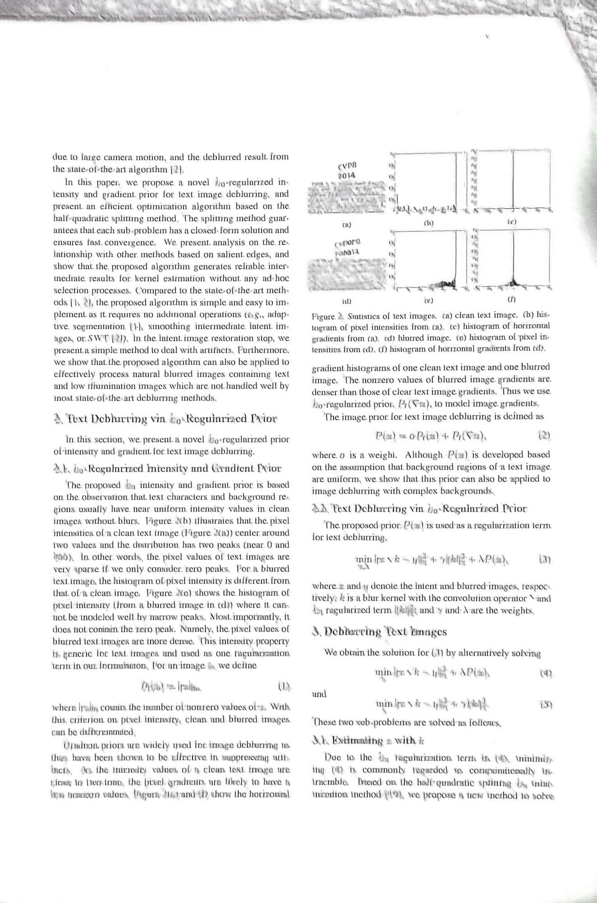
The result for image deblurring(Paper)

Slide 3
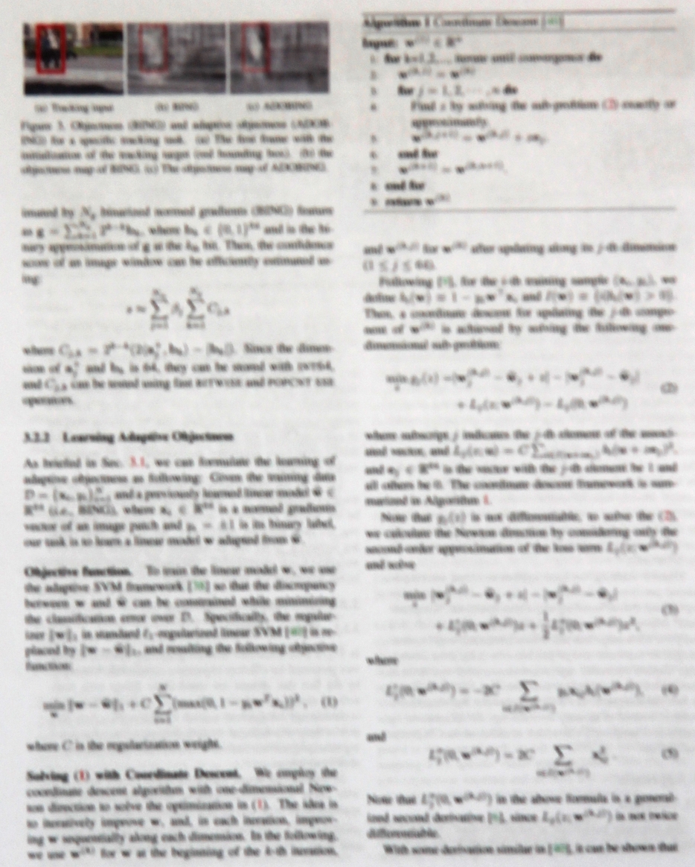
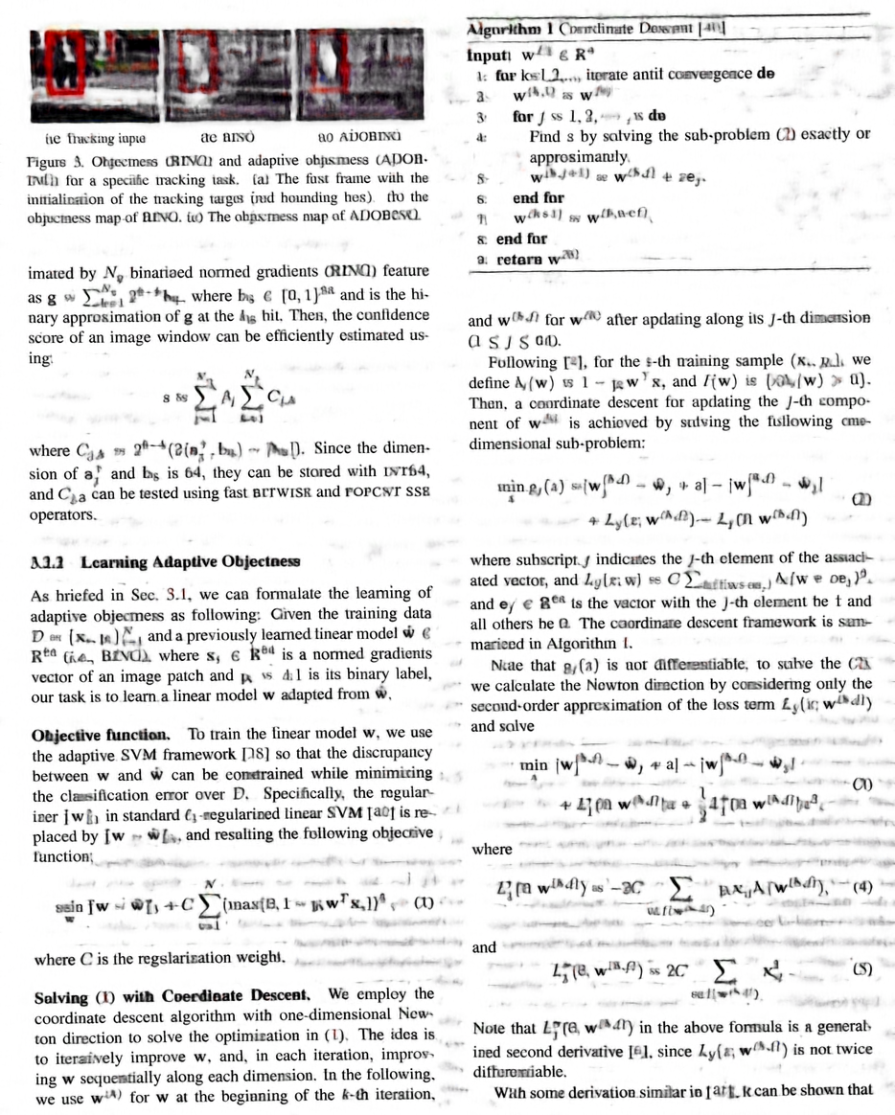
The result for image deblurring(Paper)

Slide 4
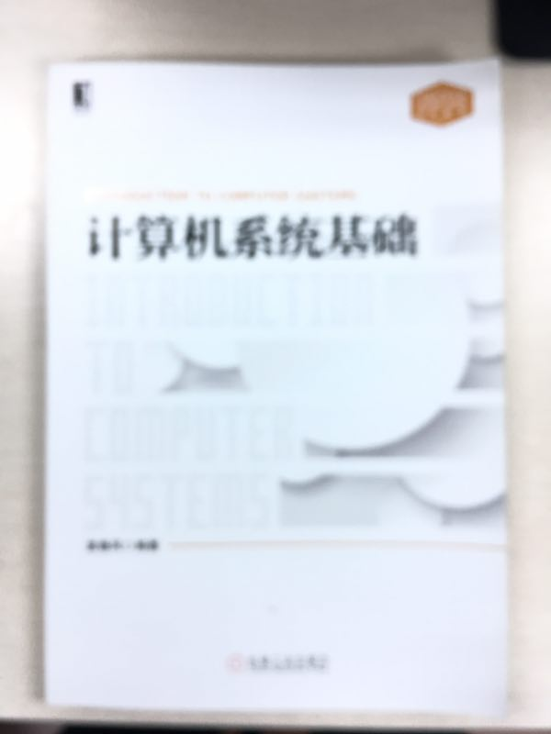
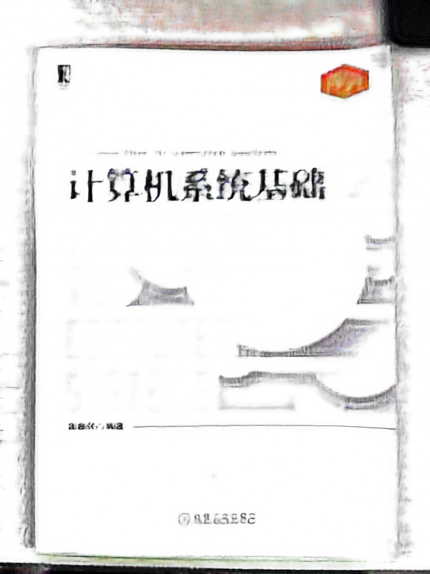
The result for image deblurring

Slide 5
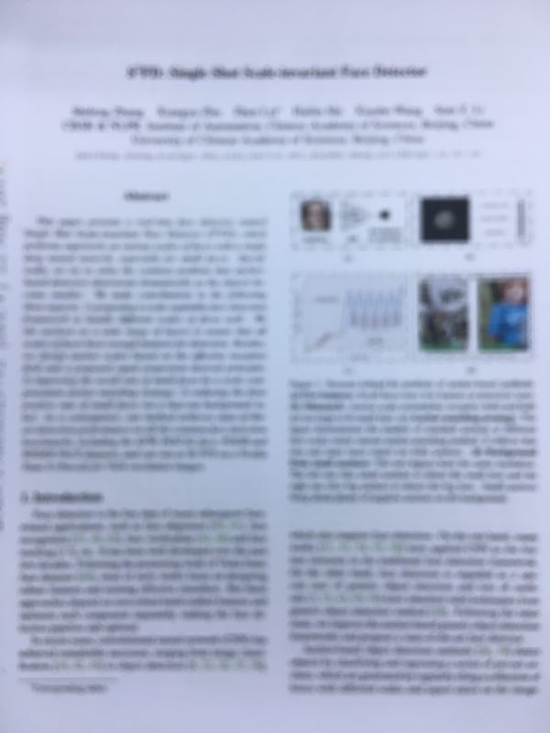
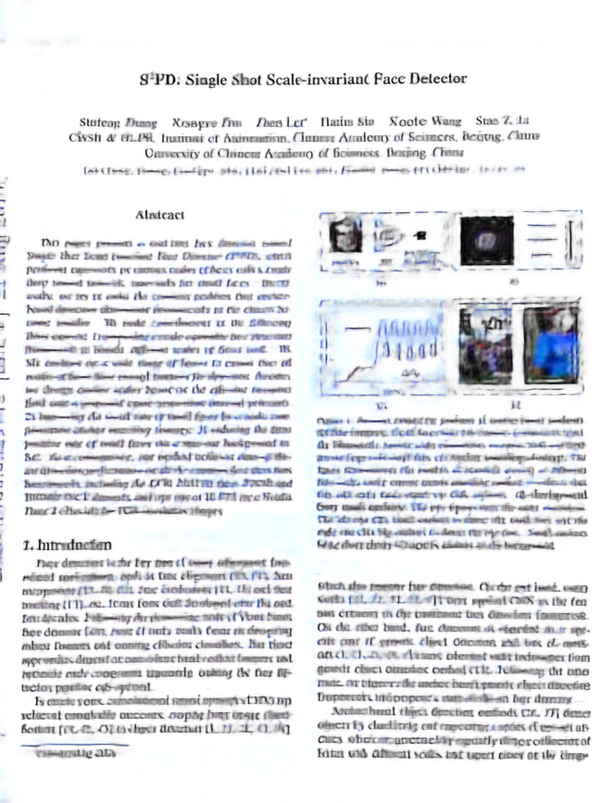
The result for image deblurring

Slide 6
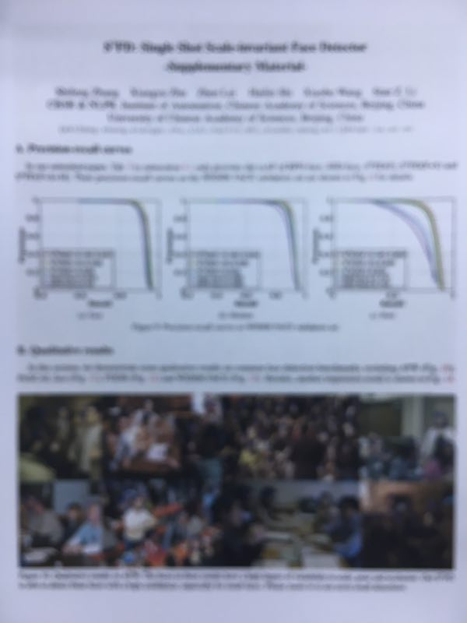
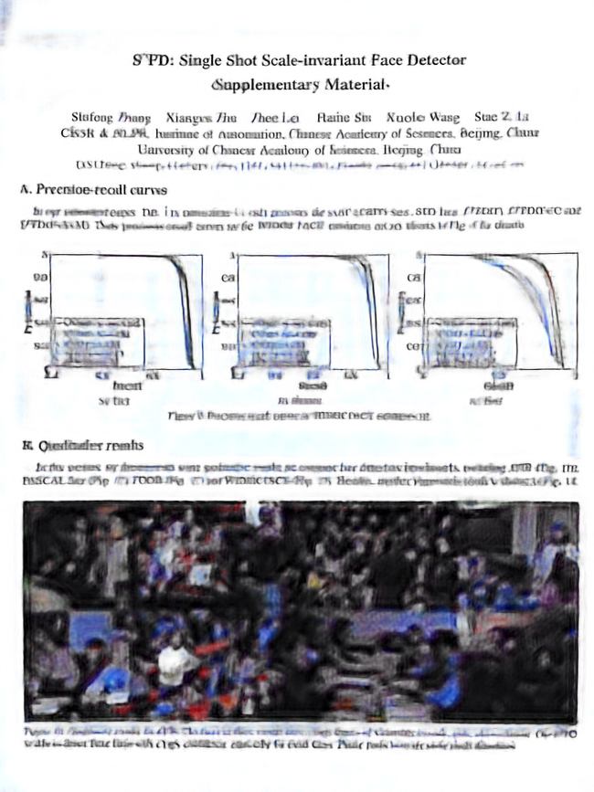
The result for image deblurring

Slide 7
THANKS

